Slide 1

20104079 Kalpesh Chavan
20104111 Siddhant Darekar
20104082 Ankit Awade
Project Guide
Prof. Neha Deshmukh

Slide 2


Topic : House Price Prediction
- Mini Project (2B)

Slide 3

Contents
Introduction
Objectives
Scope
Literature Survey
Proposed System
Project Outcomes
Block Diagram
Use Case Diagram
Technology Stack

Slide 4

1. Introduction
Problem Identified:
- Incorrect House Prices
- Property Condition
- Neighborhood Factors
- Illegal Documents
• Solution Proposed:
- The convenience
- Access anytime (24/7)
- Genuine House Prices
- Cost Saving
- Legal Documentation

Slide 5

2. Objectives
To provide a better and fast way of performing operations regarding house price
To provide proper house price to the customers
To eliminate need of real estate agent to gain information regarding house prices
To provide best price to user without getting cheated
To enable user to search home as per the budget

Slide 6

3. Scope
The website will collect real-time data related to house prices in given area
The data would be obtained from local government, property agents and other relevant sources
The website will analyze the collected data and use it to predict house prices in given areas
The website should have a friendly user interface that allows users to easily search for house prices
Collecting user feedback and incorporating it into the house price prediction model for more accurate results

Slide 7
4. Literature Survey
1 Paper : Deo, Udit. (2021). House Price Prediction. 10.13140/RG.2.2.27657.98408.
Reducing the RMSE to improve the efficiency and preciseness of the Houses in Mumbai
2 Paper: Zulkifley, Nor & Rahman, Shuzlina & Nor Hasbiah, Ubaidullah & Ibrahim, Ismail. (2020). House Price Prediction using a Machine Learning Model: A Survey of Literature. International Journal of Modern Education and Computer Science. 12. 46-54. 10.5815/ijmecs.2020.06.04.
3 Paper: Shukla, Meha. (2022). House Price Prediction Using Regression. International Journal for Research in Applied Science and Engineering Technology. 10. 344-346. 10.22214/ijraset.2022.40272. Housing is one of the major sectors of real estate and is well complemented by the growth of the urban and semi-urban accommodations. Ambiguity among the prices of houses makes it difficult for the buyer to select their dream house Our system provides a decisive housing price prediction model to benefit a buyer and seller or a real estate agent to make a better-informed decision system on multiple features. To achieve this, various features are selected as input from feature set and various approaches can be taken such as Regression Models or ANN.

Slide 8

5. Proposed System
Help or Feedback Column
-If any customer has issue regarding quality of service etc. can contact us on help or feedback Column
Neighborhood analysis
-Analyze the surrounding neighborhood to determine its impact on a property’s value
Property Comparison
-It allows buyers to compare prices, features, and locations of different properties, making it easier to find the one that best fits their needs and budget

Slide 9
Algorithm Used
Linear Regression in Machine Learning
Linear regression is one of the easiest and most popular Machine Learning algorithms. It is a statistical method that is used for predictive analysis. Linear regression makes predictions for continuous/real or numeric variables such as sales, salary, age, product price, etc.
Linear regression algorithm shows a linear relationship between a dependent (y) and one or more independent (y) variables, hence called as linear regression. Since linear regression shows the linear relationship, which means it finds how the value of the dependent variable is changing according to the value of the independent variable.
If you ever learned about supervised machine learning, then you must have heard linear regression. It is an algorithm of supervised machine learning in which the predicted output is continuous with having a constant slope. It is used to predict the values in a continuous range instead of classifying the values in the categories. Linear regression is used for performing different tasks like house price prediction. If you also want to know the method to find out house price prediction, then read our guide completely.

Slide 10

6. Outcome of Project
Users can login/register
User will be able to file a Complaint and can give a feedback
User can find out costs of various properties and areas
User can compare multiple properties to find the best property which fits in their needs and budget
Users will be aware of overall development of the surrounding areas and properties that they are interested

Slide 11
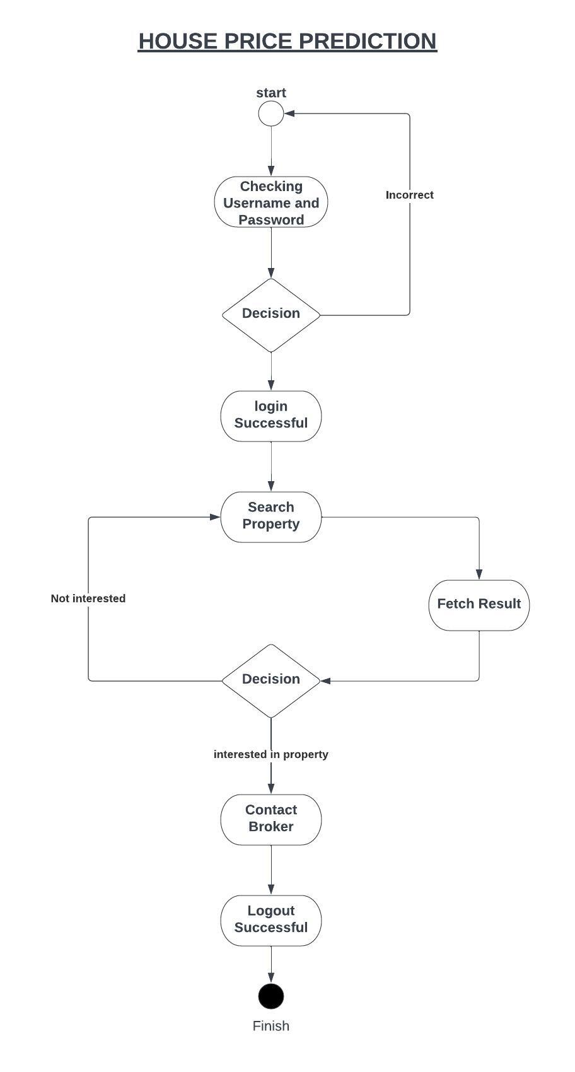
8. Block Diagriam

Slide 12
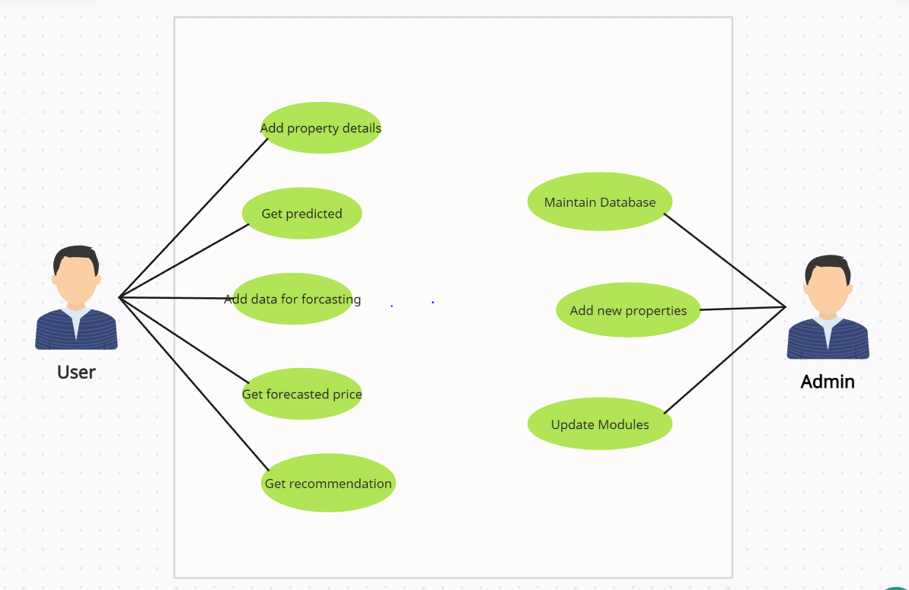
8. Use Case Diagram

Slide 13
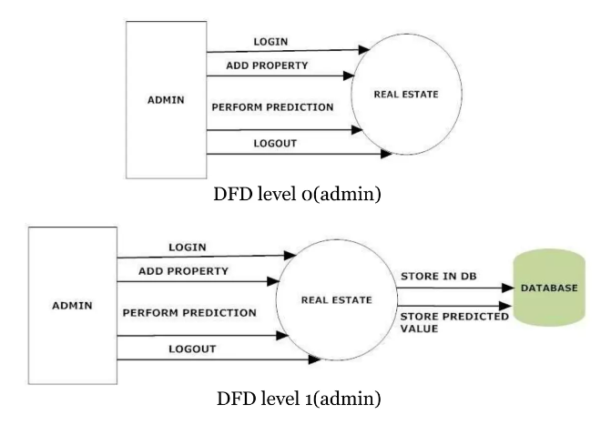
8b. Dataflow Diagram

Slide 14
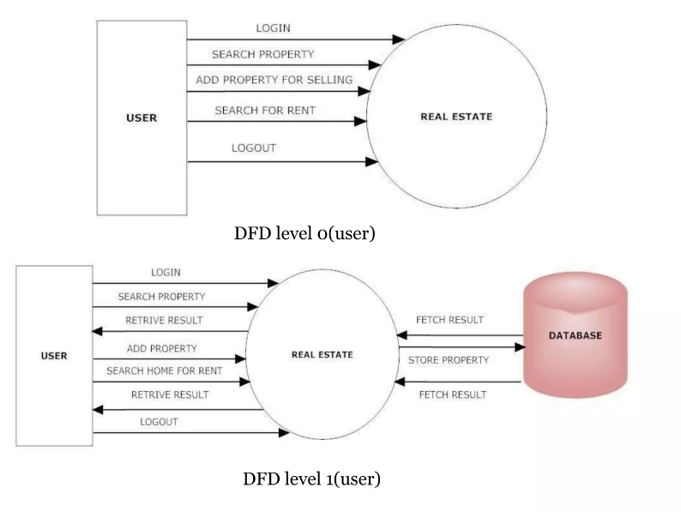
8c. Dataflow Diagram

Slide 15




9. Technology Stack
Web application built on
HTML CSS Pandas NumPy XAMPP

Slide 16


